Slide 1
Comprehensive VHDL Hamdi Abdelbagi Phone: (937) 830-7761 Email: abdelbagih1@udayton.edu

Slide 2
Text-Based Testbenches
Aim
To understand the use of text file and function
for complex test benches
Topics covered
Assert
Opening and Closing files
Converting between VHDL types and txt files
Checking Simulation results
Foreign bodies

Slide 3
Assertions
Typically used to generate a text message when something is wrong

Slide 4
Assertion Example

Slide 5
Severity Level

Slide 6
Opening and Closing Files

Slide 7
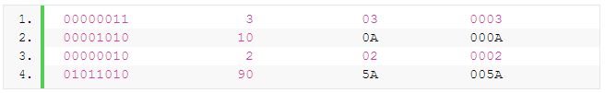
More Example
if(i_rstb='0') then
………..
------------------------------------
Elsif (rising_edge ( i_clk )) then
If (o_valid = '1') then
Write (row, o_add, right, 15);
Write (row, to_integer(o_add), right, 15);
Hwrite (row, o_add, right, 15);
Hwrite (row, "00000000"&o_add, right, 15);
Writeline (test_vector, row);
end if;
end if;
end process;

Slide 8
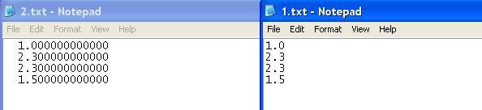
More Example
reading :process file infile : text is in "1.txt"; --declare input file variable inline : line; --line number declaration variable dataread1 : real; begin wait until clock = '1' and clock'event; if (not endfile(infile)) then --checking the "END OF FILE" is not reached. readline(infile, inline); --reading a line from the file. --reading the data from the line and putting it in a real type variable. read(inline, dataread1); dataread <=dataread1; --put the value available in variable in a signal. else endoffile <='1'; --set signal to tell end of file read file is reached. end if; end process reading;
--write process writing :process file outfile : text is out "2.txt"; --declare output file variable outline : line; --line number declaration begin wait until clock = '0' and clock'event; if(endoffile='0') then --if the file end is not reached. --write(linenumber,value(real type),justified(side),field(width),digits(natural)); write(outline, dataread, right, 16, 12); -- write line to external file. writeline(outfile, outline); linenumber <= linenumber + 1; else null; end if; end process writing;

Slide 9
Testing the File Open Status

Slide 10
Converting Values to Text Strings

Slide 11
Text Conversion Functions

Slide 12
Initializing Memories with TEXTIO

Slide 13
Foreign Bodies or “FLI” or “VHPI”

Slide 14
Uses OF The Foreign Bodies

